Slide 1
Research Methods Data Analytics

Slide 2
Common Research Methods
Archival
Experiment
Survey
Interview
Case Study
Focus Group
Content Analysis

Slide 3
Archival Research Method
Philosophy
Pragmatism ( Objectivism and Constructivism)
Approach
Predominantly Deductive
Hypothesis determines data collection
Strategies
Secondary Data - Public Archives, Public Data Sets, Social Media
Choices
Qualitative and/or Quantitative
Mono and Mixed Methods
Time Horizons
Longitudinal
Cross Sectional
Procedures
Methods: Correlation, Classification, Prediction
Analysis: Statistical Analysis, Content Analysis
Tools : Machine Learning – Classification, Regression Analysis

Slide 4
Experiment Research Method
Philosophy
Positivism – Can be tested and replicated
Approach
Deductive – Generates hypothesis to define tests
Strategies
Experiment – rigid structure, replicable research
Test causation effect on group compared to control group
Choices
Mono Method: Quantitative
Emphasis on quantifiable results
Time Horizons
Longitudinal – Concentrated samples over longer periods
Procedures
Methods: Descriptive Statistics, Comparative, Correlational
Analysis: Statistical
Tools:
Machine Learning – Classification, Regression
Programming – Python, R

Slide 5
Survey Research Method
Philosophy
Positivism – Testable hypotheses, replicable method
Approach
Deductive - Starts with hypothesis
Strategies
Survey sample group representative of population
Highly economical method of data collection
Choices
Mono Method – Quantitative
Quantifiable Data, Descriptive Research
Time Horizons
Cross Sectional - Point in time study
Procedures
Methods: Online Questionnaires
Analysis: Statistical Analysis
Tools
Online survey services
Business Intelligence Tools
Programming - R, Python

Slide 6
Research Questions
​Can hate speech classification be improved using sentiment analysis?
Which is the most accurate face recognition algorithm available in OpenCV library?
Can consumer smartwatches generate accurate clinical data?
How Feasible is Introduction of 5G Technology in Irish Airports for Data Analytics?
Do different ethical approaches produce similarly stable machine learning algorithms
How could we know if the internet resources in TUD are used primarily for academic purposes?
Do Bees continuously monitor their external temperature?

Slide 7
Predicting Company ESG Ratings from News Articles Using Multivariate Timeseries Analysis?

Slide 8
The Purpose of the Research
Hate speech classification in social media using emotional analysis
Company ESG rating predictions
Improvement on existing methodologies
Multivariate time series data concering topics, sentiment and events

Slide 9
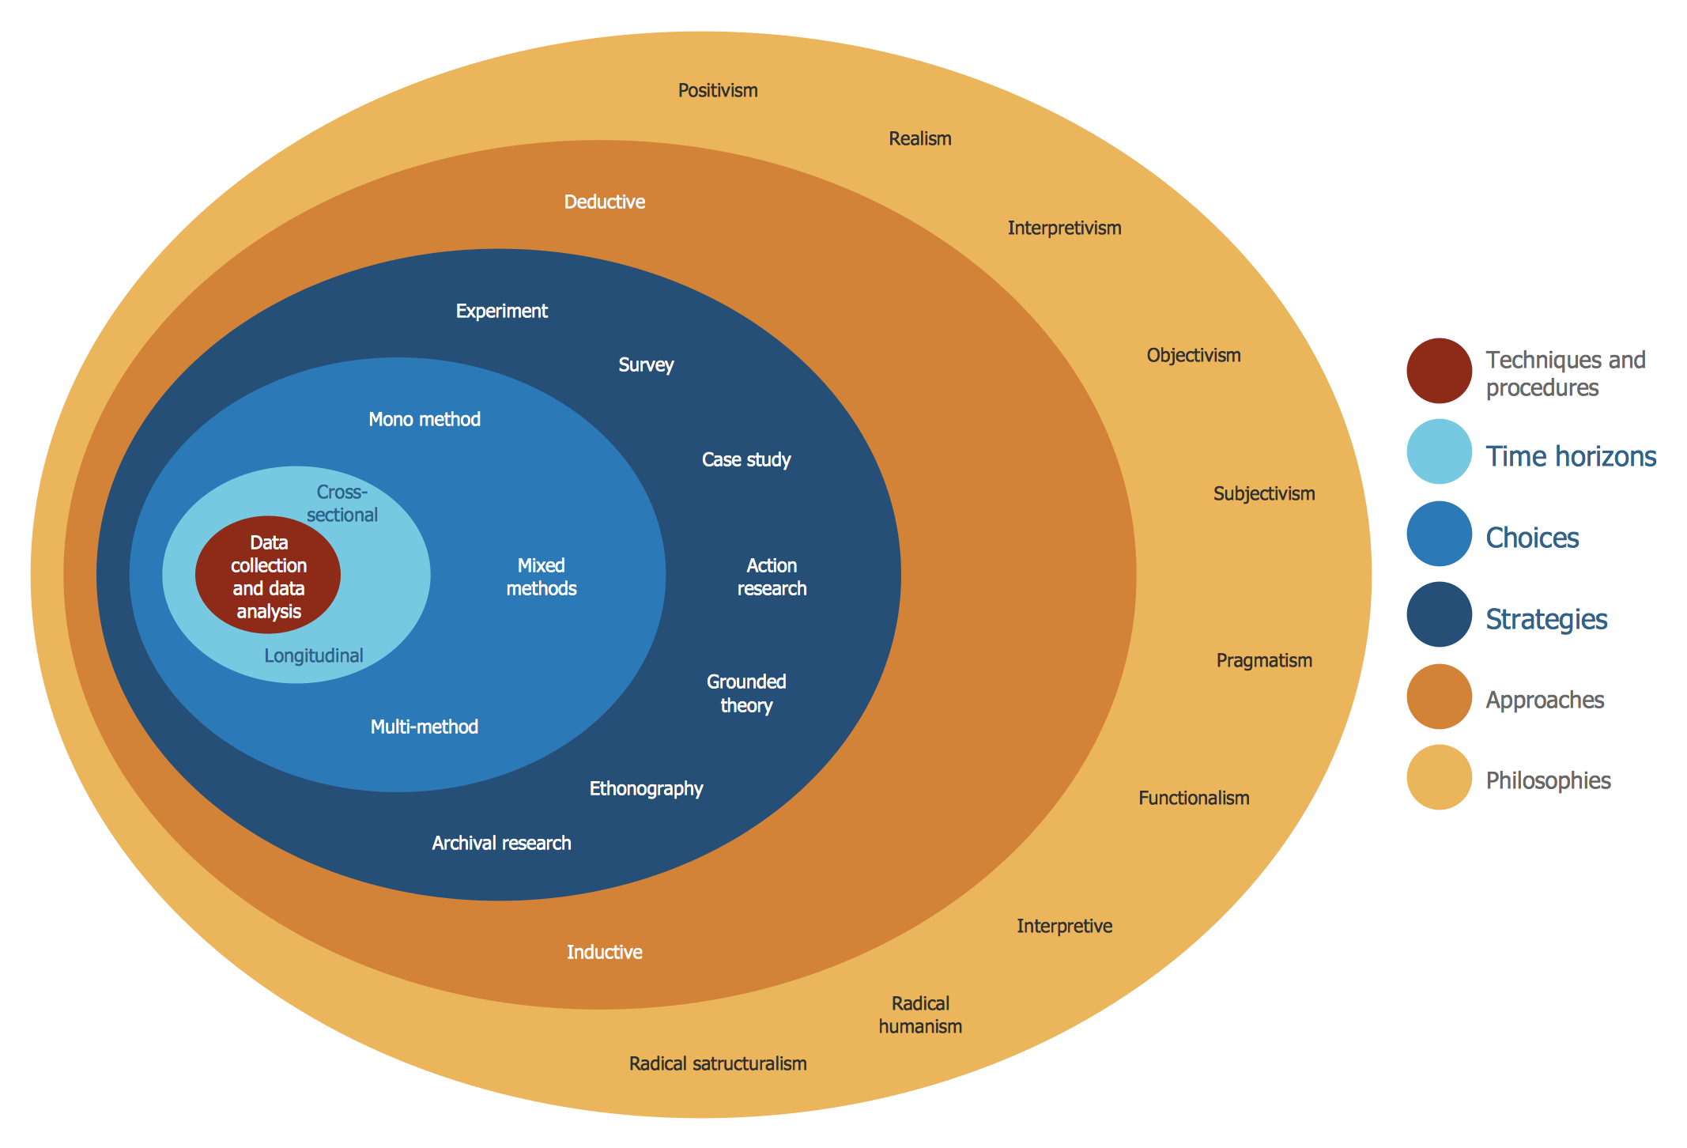

Slide 10
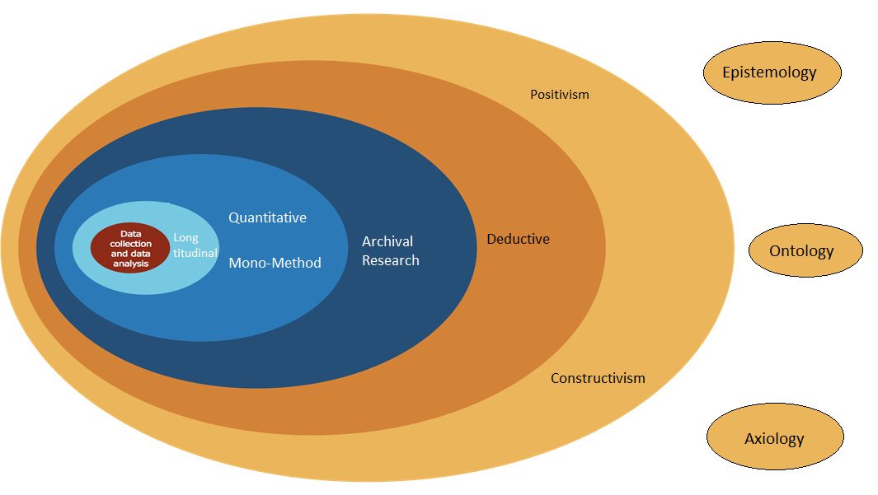
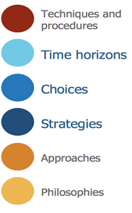
Research Onion Classification

Slide 11
Philosophy –Epistemology (what is knowledge)
It is - Positivism -
as it generates hypotheses (or research questions) that can be tested and allows explanations that are measured against accepted knowledge of the world we live in
research that can be replicated by other researchers to generate the same results.
emphasis is on quantifiable results that lend themselves to statistical analysis
It is extracting metrics, patterns and reproducible answers from data…not inferring any absolute truths, gaining a predicted accuracy….as the outcome
Knowledge is evaluated through observable data and predictive performance rather than claims of absolute truth…
Quantifiable / reproducible / testable data
It is not
Realism –
realism thinks that scientific methods are not perfect, could be realism?
theory can be revised and that our ability to know for certain what reality is may not exist without continually researching and leaving our minds open to using new methods of research.
Realism may therefore use several types of research methods to triangulate results in their search for a more reliable outcome
Time series element maps to realism -- theory can be revised and that our ability to know for certain what reality is may not exist without continually researching and leaving our minds open to using new methods of research
Interpretivism
meanings people confer upon their own and others' actions
approaches emphasizing the meaningful nature of people's participation in social and cultural life.

Slide 12
Philosophy –Ontology (whats reality)
It is – Constructivism -
social phenomena are actually constructed by social actors
law is the product of the behaviour of the group of people it now has an impact on.
It is not
Objectivism? -
social phenomena and their meanings exist separately to social actors.
We are being objective in our assessment….
There is an argument that the environmental realities – i.e. pollution are absolute realities…. And we are measuring merely reflections of the absolute realities…. i.e. media data only occurs if theres realities of temp/pollution/gdpr breaches/diversity issues etc So I could be objectivism!!!
It could be Pragmatism –!!
both constructivism and objectivism are valid ways to approach research. meanings people confer upon their own and others' actions
may be used to find solutions to problems.
Not really coming with any absolute defined version of truth… merely saying hey we can do this better to get a better solution to the problem

Slide 13
Layer 2. Approaches
It is –
Deductive
start with a statement/hypothesis or question and your research sets out to answer it.
The paper is stating “predicting ESG ratings from news articles by uniquely combining multivariate time series construction with advanced deep learning techniques”
The believe they can achieve this and then they set out to prove it…
Questions and hypothesis may be derived from informed speculation about the topic, that the researcher believes can be answered or tested
it is not
Inductive
researching to create theory.
research goes from research question to observation and description, to analysis and finally theory.

Slide 14
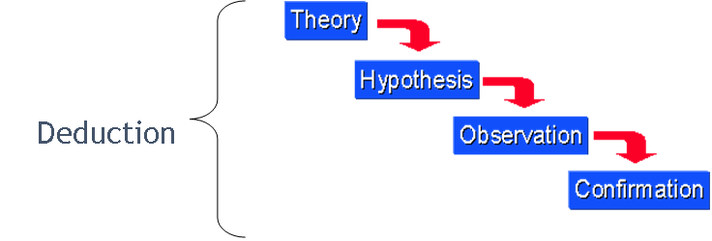

Slide 15
Layer 3. Strategy -
Archival research
data collection on existing data sets or archive documents
exploratory, explanatory or descriptive analysis of changes tracked over a long period of time.
It is not,
Experiment - no causal or control groups, no specualated measurable effect
Survey – no surveys taken
Case Study -no case studies performed
Action research - not reflective or iterative
grounded theory – does tno use indeuctive methods to predict or explain
Ethnography – is not a study of others

Slide 16
Layer 4. Choices
Is Quantitative
statistical data collected through empirical observation or from statistical digests
Is not Qaulitative
Does not rely on opinion, personal accounts etc
Is Mono-method
Only quantitative data is collected and used
Is not mixed or multi method

Slide 17
Layer 5. Time Horizons
Is Longitudinal
study events and behaviours using concentrated samples over a longer period of time.
Is not Cross - Sectional
measures an aspect or behaviour of many groups or individuals and at a single point in time.

Slide 18
Layer 6. Techniques and procedures
Experimental
Methods = Correlational, regressions classification models
Tools = python, ML, neural networks (CNNs) x2 and transformer-based x2, DistilBERT model, k-means clustering
Formal Modelling
Methods = analytical, mathematical

Slide 19
Methodology
1. Build Dataset
1.1 ESG ratings dataset creation
Used > Asset4 ESG ratings from Refinitiv1, - collected yearly ratings for 3,343 U.S. companies rated by Refinitiv from 2018 to 2020
Refinitiv scores based around E, S and G + 3 ratings, each 0-100) > higher = better
1 basic ESG score (based around company reports)
2. Controversy Score (based off external coverage, media etc)
3. combined score (controversy adjusted) (paper used this score for prediction)
Included some financials > test for company size (mrkt cap influence on ESG)
1.2 News Dataset creation
GDELT project database > https://www.gdeltproject.org/
extensive database of news covering print, web, broadcast, and television sources from most countries around the world in over 100 languages, with updates every 15 minutes.
GDELT Doc API Client
‘from gdeltdoc import GdeltDoc, Filters’
https://pypi.org/project/gdeltdoc/
Performed a keyword search to include the 10 primary themes within the three ESG dimensions and company names (variations) Ieach company name to appear twice to ensure focussed content and exclude incidental mentions

Slide 20
Overview of the News Article Dataset
 | 2018 | 2019 | 2020 | In Total
# of companies | 2665 | 2940 | 2879 | 8484
# of articles | 1,165,840 | 1,399,277 | 1,174,754 | 3,739,871
# of articles per company
average | 435 | 473 | 406 | 440
max | 1984 | 2154 | 2005 | 2154
We removed articles shorter than 200 characters and thos with HTML errors, then extracted text content using the Beautiful Soup library3#
excluded companies with fewer than five collected articles to maintain a robust sample for each entity
removed extraneous noise, such as links, email addresses, dates, Unicode characters, and newline representations, which are common byproducts of scraping.
Due to the length limitations of the BERT models we employ, each article was reduced to its title and the first five sentences, ensuring manageable input size while retaining core content.
72% were US sourced

Slide 21
Step 1.
1. Pre-label subset of articles byassessing semantic similarities to stnard definitions of 3 ESG dimensions, ESG definitions from Corporate Finance Institute (CFI),to guide the labelling. https://corporatefinanceinstitute.com/
100 artickes randomly selected served as training, validation and testing base for classifier.
create pre-trained text embeddings for these ESG definitions and the news articles using the sentence transformer model ’all-distilroberta-v1’ (SBERT) from Huggingface
Pairwise cosine similarity with > 0.1 labelled as relevant

Slide 22
Step 2.
fine-tune a pre-trained DistilBERT model [18] on this pre-labeled dataset to predict labels for the entire corpus
Articles are tokenized with the DistilBertTokenizer from Huggingface, and the tokenized inputs are then fed into DistilBERT.
DistilBERT classifier is fine-tuned in two stages
1. customized classification layers are optimized
2. entire network is fine-tuned using a lower learning rate to ensure stability
Using the trained classifier, we then predict the relevance label for each article
Not bag-of-words/tf-IDF/One-Hot/Word2vec… but BERT

Slide 23
Step 3. generate the Article2ESG Relevance time series,
Reflects the monthly relevance of articles to ESG topics
group the articles by month and by company
The monthly relevance value, 𝑟𝑒𝑙 −
𝑛𝑜𝑖𝑠𝑒𝑚, is calculated according to the following formula:
𝑟𝑒𝑙 − 𝑛𝑜𝑖𝑠𝑒𝑚 = (𝑅𝑒𝑙𝑒𝑣𝑎𝑛𝑡𝑚/𝑁𝑚) − (𝑁𝑜𝑖𝑠𝑒𝑚/𝑁𝑚)
The resulting values range between -1 (indicating only noise articles) and 1 (indicating only relevant articles). Thus, for each company,
the Article2ESG Relevance time series comprises 12 𝑟𝑒𝑙−𝑛𝑜𝑖𝑠𝑒𝑚 values, one for each month of the analyzed year.

Slide 24
Step 4 . Sentiment Analysis
To compute the sentiment time series,we group articles by company and month and calculate a monthly sentiment ratio:
employ the SieBERT model
model’s output labels are used to generate a monthly article sentiment time-series for each company, calculated separately for ESG-relevant and irrelevant articles.
𝑝𝑜𝑠 − 𝑛𝑒𝑔𝑚 = (𝑃𝑜𝑠𝑖𝑡𝑖𝑣𝑒𝑚/𝑁𝑚) − (𝑁𝑒𝑔𝑎𝑡𝑖𝑣𝑒𝑚/𝑁𝑚)
The final Article Sentiment time series is constructed by concatenating these monthly values, resulting in a time series of 12 sentiment values per company for the analyzed year.

Slide 25
Step 5. Semantic Analysis (what the articles are about)
groups articles by content, enabling us to track the evolution of key ESG-related topics discussed in the news over time
fine-tuning the DistilBERT model for the task of ES classification to create task-specific embeddings for the articles. These embeddings serve as input for the k-means clustering algorithm
The results of this semantic analysis are integrated into the final ESG rating prediction model as time series data, with each time series corresponding to one of the six clusters. (k=6 –used elbow method)
articles are grouped by cluster to identify the total set of articles within each cluster. Then, within each cluster, articles are grouped by company to quantify the overall topic representation for each company.
The resulting 12 monthly values per company and cluster are concatenated, producing 6 semantic time series for each company. These time series capture the monthly prominence of each topic cluster, showing how dominant specific ESG topics are for each company over time.

Slide 26
Step 6. ESG Rating prediction
Used four models for generating ESG ratings based on the prepared time series data:
CNN-based approaches x2
Transformer-based approaches x2
a basic model integrating CNN with a single Transformer layer, and (b) a deeper model that combines CNN with a multi-layer Transformer encoder.
Before feeding the data into the model, we standardize the time series using standard scaling (i.e. subtracting the mean and dividing by the standard deviation).
Uses Deep Learning methodologies 1D convolution, time –series dimension, ReLU to introduce non-linearity and softmax to convert outputs into probabilities

Slide 27
Evaluation of ESG Rating
classification model accuracy is relatively low due to the challenging nature of predicting the correct rating out of 100 classes, and results vary significantly depending on the train-test split.
top-performing deep CNN, the basic CNN and deep Transformer regression models show strong performance in 2020.
Values outcome from models – measures of accurracy
Mean Absolute Percentage Error (MAPE) = avg % deviation between predicted and actual ESG scores
Mean Squared Error (MSE) = average squared error.

Slide 28
Model results for 2020
 | Overall results |  |  |  | Absolute Difference to Asset4 Rating
Classification Models | Accuracy (%) | SCC |  |  | Mean Abs Diff | Std Dev | Max Diff
Basic CNN | 2.2 | 4.29 |  |  | 15.27 | 12.23 | 64.6
Deep CNN | 2.3 | 4.38 |  |  | 15.72 | 12.43 | 58.1
CNN + Transformer | 2.3 | 4.49 |  |  | 15.81 | 12.57 | 62.4
CNN + Deep Transformer | 2.2 | 5.29 |  |  | 16.44 | 12.8 | 67.8
Regression Models |  |  | Mean Abs Percent Err (MAPE) | Mean Sqrd Err (MSE) | Mean Abs Diff | Std Dev | Max Diff
Basic CNN |  |  | 51.31 | 285.07 | 13.43 | 10.2 | 52.62
Deep CNN |  |  | 50.12 | 263.18 | 13.04 | 9.66 | 48.63
CNN + Transformer |  |  | 44.18 | 368.73 | 15.05 | 11.88 | 54.41
CNN + Deep Transformer |  |  | 50.66 | 294.75 | 13.36 | 10.59 | 73.38
Baseline Model | Accuracy (%) |  | MAPE | MSE | Mean Abs Diff | Std Dev | Max Diff
Mean Asset4 Rating | 2.2 |  | 43.64 | 365.63 | 14.79 | 12.02 | 55.94
Random Selection | 0.9 |  | 102.79 | 1167.99 | 28.1 | 19.48 | 83.8
Sokolov et al. [20] | 0.5 |  | 176.27 | 2108.27 | 41.46 | 19.74 | 89.89

Slide 29
Result and Conclusions
Deep CNN
Lower
CNN + Transformer
Liwer mAPE but higher MSE => good avg accuracy but some large errors
Baselines
Very High MAPE and MSE => poor predictive performance

Slide 30
ESG Prediction Model

Slide 31
Research Methodology
Philosophy
Constructivism
Approach
Deductive
Investigates improvements to classification using emotional information to confirm theory.
Strategy
Archival Research
Classified Social Media dataset from previous research study
Choices
Mixed Method - Qualitative and Quantitative
Text content, sentiment analysis and lexical analysis
Time Horizons
Cross Sectional – Data comprises tweets from multiple users from various times
Procedures
Methods: Classification, National Language Processing
Lexical and Sentiment Analysis
Machine Learning classification models used to detect hate speech - SVM, Naïve Bayes, Random Forest Trees.

Slide 32
Which is the most accurate face recognition algorithm available in OpenCV library?

Slide 33
The Purpose of the Research
Computer Vision Library (OpenCV)
Implemented Face Recognition Algorithms:
- Local Binary Pattern (LBP)
- Fisherface
- Eigenface
Which one to pick and when?

Slide 34
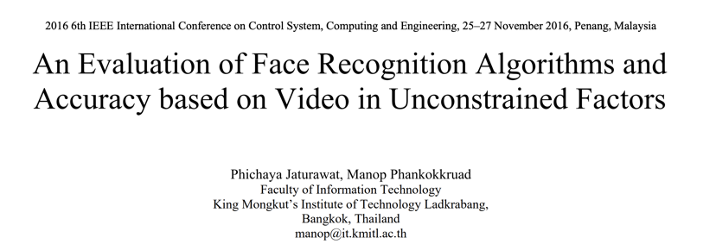

Slide 35
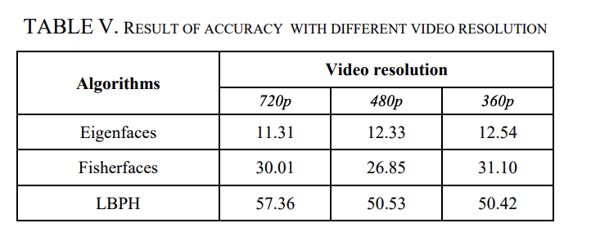
Research Methodology
Basic Research: fills in the knowledge we don’t have. Which algorithm to use, which performs the best, under what circumstances?
Inductive Research: beginning with collecting data to answer the research question – which algorithm is the most accurate?
Quantitative Research - collected data will be expressed in numbers and graphs (table 5)
Research Method: Experimental Research

Slide 36
Can consumer smartwatches generate accurate clinical data?
John McDonnell
D19126351

Slide 37
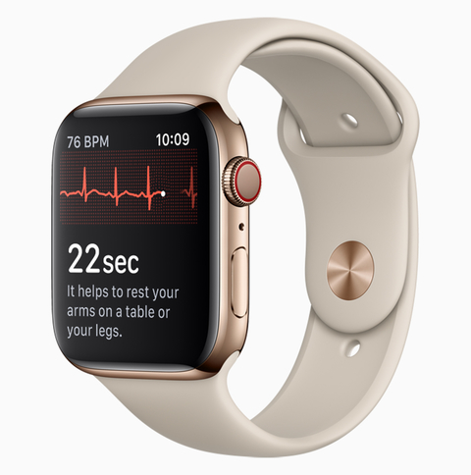
The Purpose of the Research
Large-Scale Assessment of a Smartwatch to Identify Atrial Fibrillation (study by Apple & Stanford University)
Atrial Fibrillation is an irregular heartbeat, can affect up to 1 in 3 people (in the US), and is associated with a quintupling the risk of stroke.
Detected arrhythmias were assessed and eligible participants were mailed an ECG patch to wear for up to 7 days.
Participants with serious arrhythmias were contacted immediately and directed to seek urgent medical care.
All enrolled participants were directed to a web-based end-of-study survey.

Slide 38
The Research Methodology
Methodology | Reasoning
- Quantitative Research - Qualitative Research - Applied Research | We are dealing with observations generated by the Apple Watch recorded as quantities. Survey generated qualitative data. Designed to solve a practical problem.
L1: Philosophy: - Positivism (from Epistemology) - Objectivism (from Ontology) | The emphasis is on quantifiable results that lend themselves to statistical analysis. This is a closed world. Social phenomena and their meanings exist separately to social actors.
L2: Deductive Approach | We are setting out to assess whether a smart watch can identify Atrial Fibrillation. We start with a theory (hypotheses) and move towards observations.
L3: Research Strategies: - Experiment - Survey | The results of the experiment are examined against the expected results. Is more rigid in its structure and process to enable the research to be replicated. End-of-study survey collects additional quantitative as well as qualitative data .
L4: Choices Mixed Method | Both Quantitative data (data generated in study for AF detection) and Qualitative (survey at beginning and end of study).
L5: Time Horizons Cross-sectional | Short term study (median of 117 days). Single point in time.
L6: Techniques and Tools: - Survey - Statistical Analysis - Observational study | Survey using smartphone app. Statistical techniques used to aggregate and analyse results at a predefined confidence level (90%). Observational Survey: sensors on smart watch.

Slide 39
Conclusions and Further Research
Provides a foundation for outcomes or adherence to be reliably assessed with user-owned consumer wearable devices.
Gap: Data is based on US participants only and may be skewed towards the health, lifestyle and demographics of people in that country.
Gap: 25% of participants that received irregular pulse notification had to be excluded because of previous a-fib and/or were already on medication for the condition. Better control for initial study eligibility survey.
Gap: Sample was skewed towards a younger demographic since they were more likely to own a smartwatch.

Slide 40
How Feasible is Introduction of 5G Technology in Irish Airports for Data Analytics?

Slide 41
The Purpose of the Research
The airport – an open but chaotic place. People want to get from A to B as seamlessly as possible – the reality is far from this. Can data analytics improve this?
5G technology is being rolled out to the public – but comes with its limitations along with its advantages. How suitable is this for this project?
Define the challenges/risks involved in such large-scale data gathering.
Define the benefits of implementing this technology to improve smooth flow of passengers and improve the airport’s business.
Define possible ethical alternative methods or technology to 5G technology.

Slide 42
Research Methodology
Formation of the questions to be investigated for primary research through analyzing previously conducted research in similar areas of study.
Conducting the surveys, interviews and pilot experiment and critically analyzing the results with previously conducted primary research and their analysis.
Stating any interesting findings of the primary research and stating any similarities/dissimilarities with previous researches.
Making recommendations based on the benefits and challenges.

Slide 43
Research Methods
Secondary Research – Published Journals, Thesis, Related Literature (books, information booklets)
Primary Research – Public surveys(quantitative data), Interviews(qualitative data), Potential testing of the technology (experimental and quantitative data).

Slide 44
Do different ethical approaches produce similarly stable machine learning algorithms

Slide 45

The Purpose of the Research
Ethical artificial intelligence Is a primary requirement for increased confidence and trust between human and machine
Most of the current research on ethical approaches for autonomous systems focus on applying the ethical principle of preventing harm
Integrating consistent and reliable ethical principles into Artificial Intelligence reasoning bridges a major gap and allows autonomous machines to mimic human behaviour and decision making
[2]

Slide 46
Background
Hypothesis
The mean number of ethical outcomes from a Machine Learning (ML) model does not differ based on the applied ethical agent
Focus on three main approaches to ethics [1]
Deontology
Consequentialism
Virtue ethics
In this context “stable” is defined as consistently producing a predictable outcome

Slide 47
Methodology
Create several instances of a ML model and separate into 3 groups
Train each instance on a specified ethical agent
Generate a series of scenarios with a clearly defined ethical outcome
Apply scenarios to ML models
Assess results
Considerations
Morally neutral
Exceptions
Designer bias

Slide 48
Method
Quantitatve data – Models will be scored based on outcome
Applied research – Looking for a relationship (Experimental)
Descriptive research – Comparative
Research onion
Philosophy – Ontology(Constructivism)
Approach – Deductive
Strategy – Experimental
Choices - Mixed methods

Slide 49
How could we know if the internet resources in TUD are used primarily for academic purposes?

Slide 50
The Purpose of the Research
Internet is very important to the academic success
The usage of it can be for both academic and non-academic purposes
This research will be done by recording the daily internet bandwidth usage for the university
Data collected will be both for upload and download traffic (in and out) using flows.
Data is be further analyzed into which traffic is ‘good’ vs traffic that is ‘bad’
Classification of the data will be done using machine learning techniques
The traffic monitoring and analysis will not capture individual details and therefore the study is ethical

Slide 51
The Research Methodology
Methodology | Reasoning
- Quantitative Research - Qualitative Research - Applied Research | Measuring the capacity usage for each flow which is numeric data. Narrative of the data flows with the packet signatures to understand what type of traffic it. Trying to solve the problem of students not using the internet well enough for academic purposes
L1: Philosophy: - Objectivism (from Ontology) - Interpretivism (from Epistemology) | Social phenomena (Internet usage) and the actors (students) exits separately Analysing students' usage of the internet with respect to their academics.
L2: Deductive Approach | It is believed that we can identify the traffic that is making good use of the internet.
L3: Research Strategies: - Case study | We are basing the research focus on just one school - TUD
L4: Choices Mixed Method | Both Quantitative data (bandwidth usage) and Qualitative (flow of the data).
L5: Time Horizons Longitudinal | Study can take about 1-3 months.
L6: Techniques and Tools: - Observational - Statistical Analysis - | Traffic capture on the internet routers Machine learning approach to classify the data using either python, R or SAS

Slide 52
Do Bees continuously monitor their external temperature?
Kalpana Konety
D19124997

Slide 53
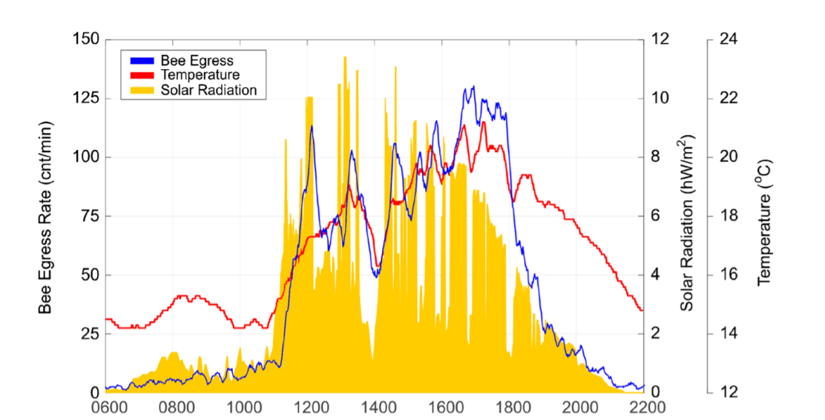
The Purpose of the Research
Predictive modelling of honeybee foraging activity using local weather conditions (University of Bristol, UK)
Save the Bees.
Identify meteorological conditions that endanger bee colonies.
To continuous, remote monitoring of honeybee colonies with possible implications for early detection and prevention of hive abandonment disorders (a possible warning system for beekeepers).
Help to determine if anomalously large errors in prediction correlate to pesticides presence.
Figure: Example day of data (7 June 2014) showing bee egress rate (blue), temperature (red) and solar radiation (orange, filled). This day began with cloud cover until shortly after 11 am. Immediately after the clouds cleared, indicated by an increase in solar radiation then temperature, the bees begin to leave the hive at an increased rate.

Slide 54
The Research Methodology
Methodology | Reasoning
Quantitative Research Applied Research Analytical Research | Measured quantifiable data like bee egress rate, temperature, solar radiation, rain and humidity etc. Conducted Spearman rank/person method to calculate correlation between temperature and bee ER and solar radiation and bee ER. To solve a practical problem of bee population decline. Attempts to explain how/why bee foraging changes with meteorological conditions.
L1: Philosophy: Positivism (from Epistemology) Objectivism (from Ontology) | Predictive model created can be replicated by other researchers to generate the same results. Social phenomena like temperature, rain exist separately to social actors
L2: Approaches: Deductive Approach | Started with a question, and research provided with an answer.
L3: Research Strategies: Experiment Action research Grounded Theory | The results of the experiment are examined against the expected results. Is more rigid in its structure and process to enable the research to be replicated. Have a clear objective. Problem-solving approach to a specific research problem Prediction being generated

Slide 55
The Research Methodology
Methodology | Reasoning
L4: Choices Mono-Method | Quantitative data measured for experiment include bee egress rate along with temperature, solar radiation, atmospheric pressure, humidity, rainfall, wind direction and speed.
L5: Time Horizons Cross-sectional | Short term study (42 days between June-Sep in 2013, 74 days between July-Sep in 2014).
L6: Techniques and Tools: Data collection Analysis | Experimental output (numeric-data), collected from two different hives. Statistical analysis of numeric data. Correlation between temperature and Bee forage, solar radiation and bee forage. Predictive analysis using linear regression model.

Slide 56
Conclusions and Further Research
Bee foraging effort, measured as the number of bees that leave the hive on foraging flights in each minute, is tightly coupled to the coincident meteorological conditions near the hive.
Most important conditions temperature and solar radiation.
The reaction period between changes in weather conditions and changes in bee foraging activity is less than 1 min. These results suggest that bees continuously monitor their external environment and use the informational gained to make decisions about whether to embark on foraging journeys.
This knowledge could lead to better informed conservation efforts of domesticated and wild bees in general and improved colony management by commercial bee keepers.
Gap: Experiments are conducted only during months from June and Sep.
So, rest of the year conditions are not known.

Slide 57
References
Gomes, Marco & Novais, Paulo & Henriques, Pedro. (2018). Hate Speech Classification in Social Media Using Emotional Analysis. 61-66. 10.1109/BRACIS.2018.00019.
Jaturawat, P., & Phankokkruad, M. (2016). An evaluation of face recognition algorithms and accuracy based on video in unconstrained factors. 2016 6th IEEE International Conference on Control System, Computing and Engineering (ICCSCE). doi: 10.1109/iccsce.2016.7893578
Perez, M. V., Mahaffey, K. W., Hedlin, H., Rumsfeld, J. S., Garcia, A., Ferris, T., … Turakhia, M. P. (2019). Large-Scale Assessment of a Smartwatch to Identify Atrial Fibrillation. New England Journal of Medicine, 381(20), 1909–1917. doi: 10.1056/nejmoa1901183
N. Le, Y. Zheng, Q. Huang and Y. Pei, "Prospect of 5G Application in Civil Airport," 2019 IEEE 1st International Conference on Civil Aviation Safety and Information Technology (ICCASIT), Kunming, China, 2019, pp. 591-595.
P. Popovski, K. F. Trillingsgaard, O. Simeone et al., "5G Wireless Network Slicing for eMBB URLLC and mMTC: A Communication-Theoretic View", IEEE Access, pp. 1-1, 2018.
[1]Bench-Capon, T. J. M. ‘Ethical Approaches and Autonomous Systems’. Artificial Intelligence 281 (1 April 2020): 103239. https://doi.org/10.1016/j.artint.2020.103239.
Adekitan, A. I., Abolade, J., & Shobayo, O. (2019). Data mining approach for predicting the daily Internet data traffic of a smart university. Journal of Big Data, 6(1). doi: 10.1186/s40537-019-0176-5
Yuan, R., Li, Z., Guan, X., & Xu, L. (2008). An SVM-based machine learning method for accurate internet traffic classification. Information Systems Frontiers, 12(2), 149–156. doi: 10.1007/s10796-008-9131-2
Clarke, Dominic & Robert, Daniel. (2018). Predictive modelling of honey bee foraging activity using local weather conditions. Apidologie. 49. 10.1007/s13592-018-0565-3.
[2]Frankish, K., & Ramsey, W. M. (2014). The Cambridge Handbook of Artificial Intelligence. Cambridge University Press.

